Slide 1
Data Science
Unit-III
Multidimensional Scaling
Source: Web resources

Slide 2
Multidimensional Scaling (MDS)
MDS is a method for visualizing similarities or dissimilarities between items.
Given a matrix of pairwise distances (or dissimilarities), MDS aims to place each item as a point in a lower-dimensional space (often 2D or 3D) such that the projected distances approximate the original distances.
It is Supervised learning Dimensionality reduction.
Used for Non-linear type data, Many-fold data
It reduces n-dimensionality to lower dimensionality while preserving distances b/w samples.
MDS uses similarity or dissimilarity measure( Euclidian distance)
In this case two Methods can used
  1. MDS
  2. Isomaps

Slide 3
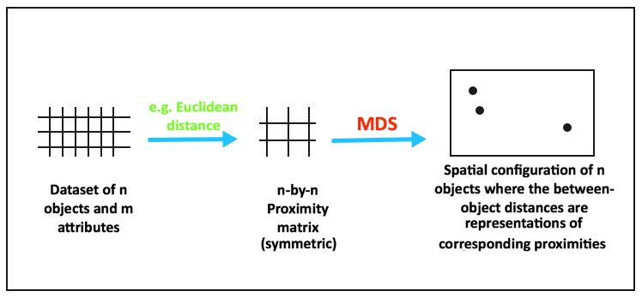
Introduction
Dimensionality Reduction: PCA, Linear Discriminant Analysis(LDA).
Multidimensional scaling (MDS) is a technique that creates a map displaying the relative positions of several objects, given only a table of the distances between them.
The map may consist of one, two, three, or even more dimensions.
The program calculates either the metric or the non-metric solution.
The table of distances is known as the proximity matrix. It arises either directly from experiments or indirectly as a correlation matrix.

Slide 4
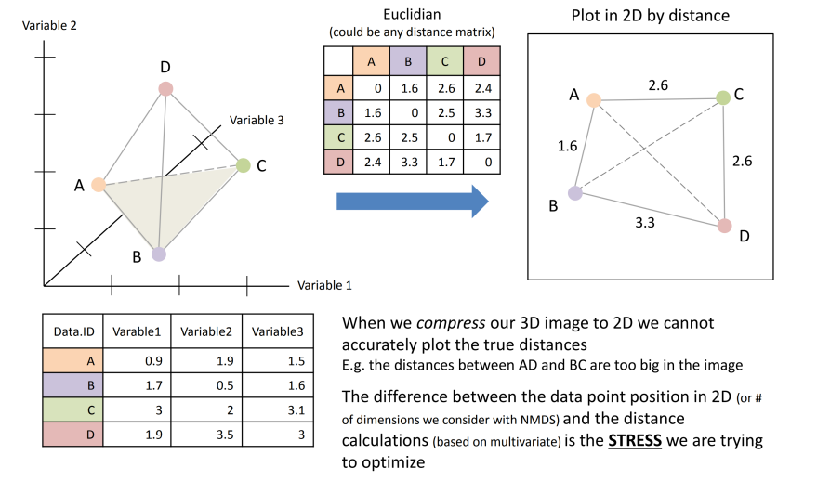
Example:

Slide 5
Types of Multidimensional Scaling
Classical (metric) MDS: Assumes the dissimilarities are Euclidean distances and tries to preserve them linearly.
Nonmetric MDS: Only the rank ordering of distances matters (i.e. relative closeness). It is more flexible when the dissimilarities are ordinal rather than metric.
Generalized / non-Euclidean MDS: Embeds into spaces other than flat Euclidean space (e.g. curved surfaces).
Majorization methods: Optimization techniques to iteratively reduce the stress (error) function.

Slide 6
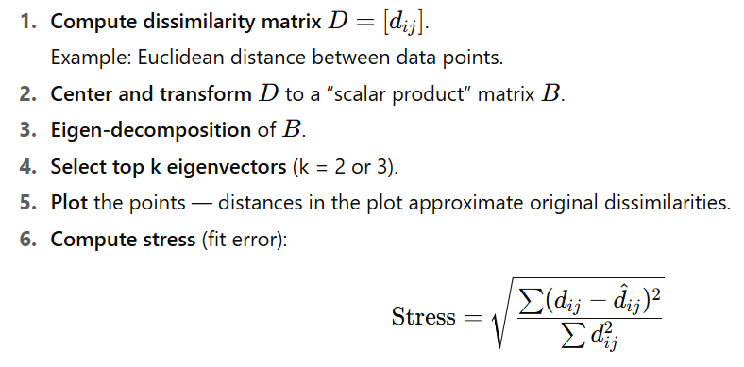
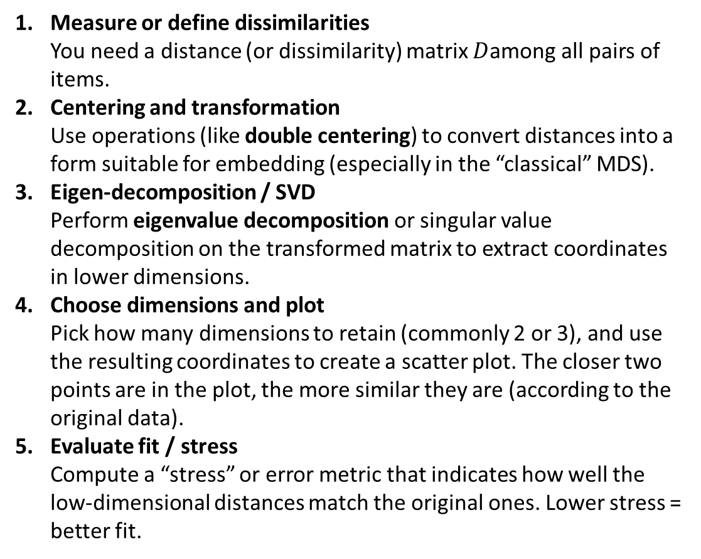
Multidimensional Scaling: How it works ??
Measure or define dissimilarities
You need a distance (or dissimilarity) matrix $D$among all pairs of items.
Centering and transformation
Use operations (like double centering) to convert distances into a form suitable for embedding (especially in the “classical” MDS).
Eigen-decomposition / SVD
Perform eigenvalue decomposition or singular value decomposition on the transformed matrix to extract coordinates in lower dimensions.
Choose dimensions and plot
Pick how many dimensions to retain (commonly 2 or 3), and use the resulting coordinates to create a scatter plot. The closer two points are in the plot, the more similar they are (according to the original data).
Evaluate fit / stress
Compute a “stress” or error metric that indicates how well the low-dimensional distances match the original ones. Lower stress = better fit.

Slide 7
Procedure for Multidimensional Scaling
Formulate the Problem
Obtain Input Data
Select an MDS Procedure( Calculate Proximity matrix with similarity or dissimilarity values with Euclidian Distance )
Decide on the Number of Dimensions (generate New dimensions(lower) with 1. Eigen Decomposition method, 2. Optimizer method
Label the Dimensions and Interpret
the Configuration

Slide 8
1. Formulate the Problem
Specify the purpose of MDS.
Select the brands to be included in the analysis. Usually varies between 8 and 25 brands.
The choice of number and specific brands should be based on the marketing research problem, theory, and the judgment of the researcher.

Slide 9
2. Input Data for Multidimensional Scaling
MDS Input Data
Perceptions
Preferences
Direct (Similarity Judgments)
Derived (Attribute Ratings)

Slide 10
Direct Approach: Advantages and disadvantages
The direct approach has the following advantages and disadvantages:
1.The researcher does not have to identify a set of salient attributes.
2. The disadvantages are that the criteria are influenced by the brands or stimuli being evaluated.
3. Furthermore, it may be difficult to label the dimensions of the spatial map.

Slide 11
Derived Approach: Advantages and disadvantages
The attribute-based approach has the following advantages and disadvantages:
1. It is easier to label the dimensions.
2. A disadvantage is that the researcher must identify all the salient attributes, a difficult task.
Use both these approaches. Direct similarity judgments used for obtaining the spatial map, and attribute ratings used to interpret dimensions of the perceptual map.

Slide 12
3. Select an MDS Procedure: Types of MDS
Whether perception or preference data are being scaled, or whether the analysis requires both kinds of data.
The nature of the input data is also a determining factor.
  Non-metric MDS procedures assume that the input data are ordinal, but they result in metric output.
  Metric MDS methods assume that input data are metric (Interval scaled, Ratio scaled attributes). Since the output is also metric, a stronger relationship between the output and input data exists.
  Classical MDS: Also known as Principal Coordinates Analysis (PCoA), it uses eigenvalue decomposition of the distance matrix.
  ( One matrix), Weighted MDS (several Matrices used)
  The metric and non-metric methods produce similar results.
Another factor influencing the selection of a procedure is whether the MDS analysis will be conducted at the individual respondent level or at an aggregate level.

Slide 13
4. Identify the Number of Dimensions
To generate new lower dimension , we can use two methods: a. Eigen Decomposition: Calculate eigen vector for Proximity matrix. Calculate new lower dimension with multiply Eigen vector with original data.
b. Optimizer method: Use Stress function calculate goodness-fit
In stress function: It calculate predicted and actual distances- it should be minimize the difference
A priori knowledge - Theory or past research
Interpretability of the spatial map - Difficult to interpret in more than three dimensions.
Elbow criterion - A plot of stress versus dimensionality.
Statistical approaches - Statistical approaches are also available for determining the dimensionality.

Slide 14
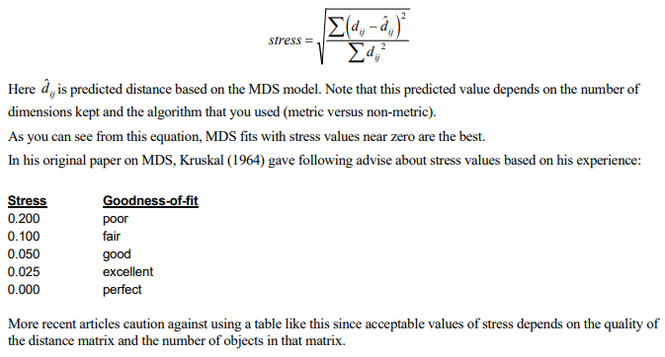
Identify the Number of Dimensions: b. Optimizer method: Stress function Goodness-of-fit
In the case of MDS, you are trying to model the distances. Hence, the most obvious choice for a goodness-of-fit statistic is one based on the differences between the actual distances and their predicted values. Such a measure is called stress and is calculated as values

Slide 15
Identify the Number of Dimensions:
One of the goals of the MDS analysis is to keep the number of dimensions as small as possible.
Usually, the analyst will anticipate select two or, at most, three dimensions.
If more are required, you may decide that MDS is not appropriate for your data
The usual technique is to solve the MDS problem for a number of dimension values and adopt the smallest number of dimensions that achieves a reasonably small value of stress.
The program displays a simple bar chart of the stress values to aid in the selection of the number of dimensions

Slide 16
5. Label and Interpret Dimensions
Even with direct similarity judgments, ratings of the brands on attributes may still be collected. These attribute vectors may be fitted in the spatial map.
Respondents may be asked to indicate the criteria they used in making their evaluations.
If objective characteristics of the brands are available these could be used to in interpreting the subjective dimensions of the spatial maps.

Slide 17
Assess Reliability and Validity
On the index of fit, or R-square values of 0.60 or better are considered acceptable.
Stress values measure badness-of-fit, or the proportion of variance of data that is not accounted for by the MDS model. Stress values of less than 10% are considered acceptable.

Slide 18
Applications of the MDS
Image measurement
Brand positioning
market segmentation
New product development
Assessing Adverting effectiveness
Pricing Analysis
Channel Decisions

Slide 19
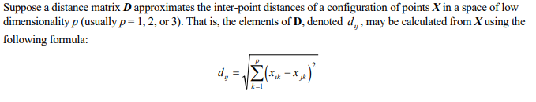
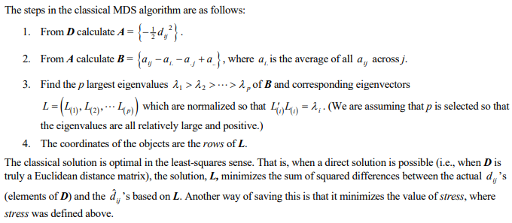
The steps in the classical MDS algorithm:

Slide 20
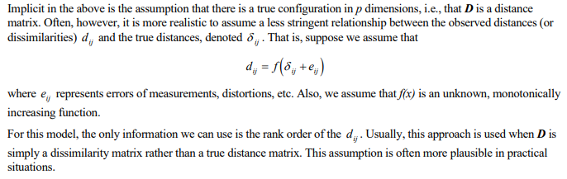
Non- Metric MDS:

Slide 21
MDS: Case study Perceptual mapping of Toothpaste
Perception Data: Direct Approaches: respondents are asked to judge how similar or dissimilar the various brands are. These data are referred to as similarity judgments.
Consider similarity ratings of various toothpaste brands:
Very Very
Dissimilar Similar
Crest vs. Colgate 1 2 3 4 5 6 7
Aqua-Fresh vs. Crest 1 2 3 4 5 6 7
Crest vs. Aim 1 2 3 4 5 6 7
.
.
.
Colgate vs. Aqua-Fresh 1 2 3 4 5 6 7
The number of pairs to be evaluated is n (n -1)/2, where n is the number of stimuli.

Slide 22
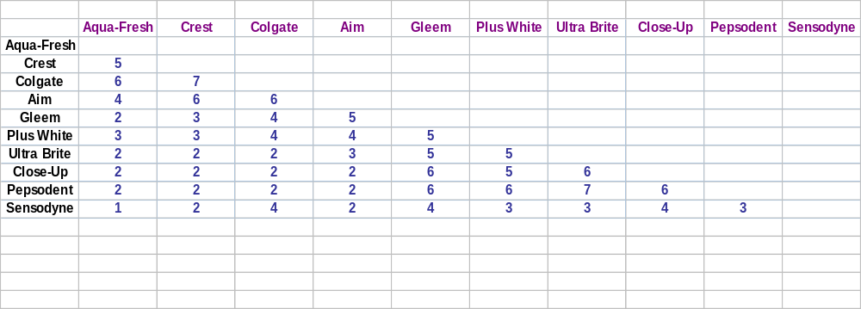
Case study: Similarity Rating Of Toothpaste Brands

Slide 23
Case study: Input Data
Perception Data: Derived Approaches: Attribute-based approaches requiring the respondents to rate the brands on the identified attributes using semantic differential or Likert scales.
Whitens Does not
teeth ___ ___ ___ ___ ___ ___ ___ ___ ___ ___ whiten teeth
Prevents tooth Does not prevent
decay ___ ___ ___ ___ ___ ___ ___ ___ ___ ___ tooth decay
.
.
.
Pleasant Unpleasant
tasting ___ ___ ___ ___ ___ ___ ___ ___ ___ ___ tasting
If attribute ratings are obtained, a similarity measure (such as Euclidean distance) is derived for each pair of brands.

Slide 24
Plot of Stress Versus Dimensionality
0.3
0.2
Stress
0.1
0.0
0
1
2
3
4
5
Number of Dimensions

Slide 25
A Spatial Map of Toothpaste Brands
2.0
1.5
1.0
Plus White
Aim
0.5
Ultrabrite
Gleem
Crest
Pepsodent
0.0
Colgate
-0.5
Close Up
Aqua- Fresh
-1.0
Sensodyne
-1.5
-2.0
-2.0
-1.5
-1.0
-0.5
0.0
0.5
1.0
1.5
2.0

Slide 26
Using Attributes to Label Dimensions
2.0
1.5
1.0
Plus White
Aim
0.5
Ultrabrite
Gleem
Crest
Fights Cavities
Pepsodent
0.0
Close Up
Colgate
-0.5
Aqua- Fresh
Whitens Teeth
-1.0
Sensodyne
-1.5
Sensitivity Protection
-2.0
-2.0
-1.5
-1.0
-0.5
0.0
0.5
1.0
1.5
2.0

Slide 27
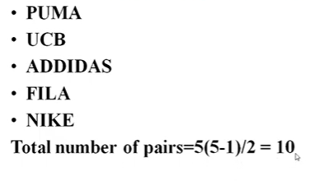
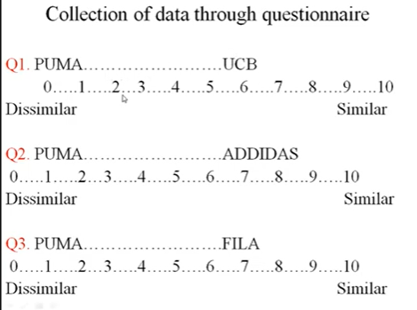

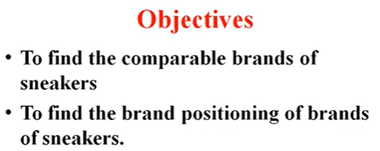
MDS: Case study Perceptual mapping of Sneakers (one matrix)

Slide 28
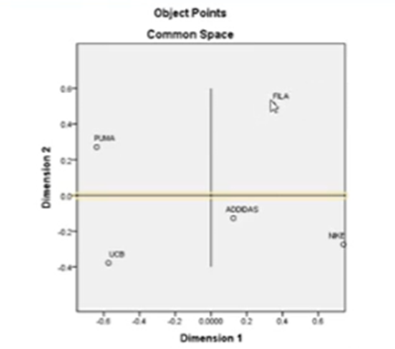
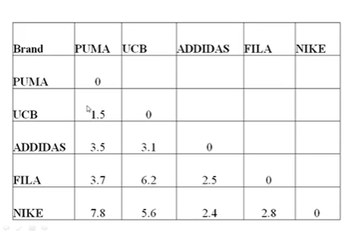
Case study

Slide 29
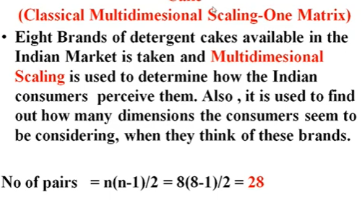
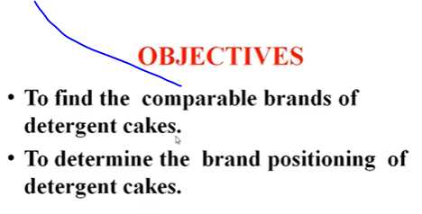
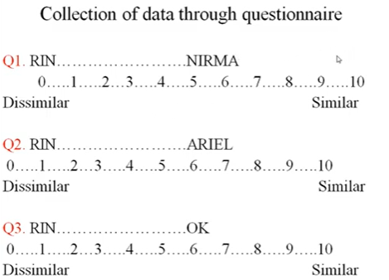
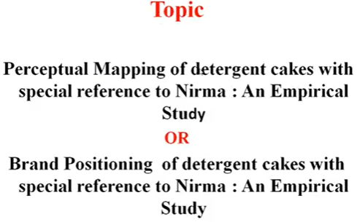
MDS: Case study: Detergent cakes

Slide 30
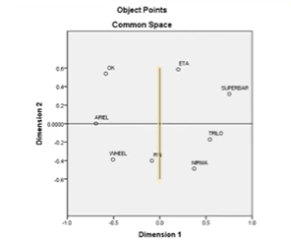
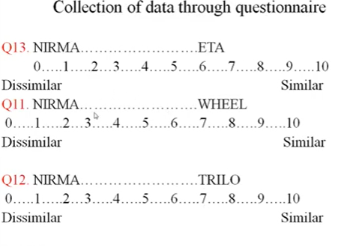
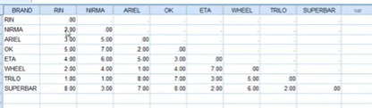
Case study: perceptual space

Slide 31
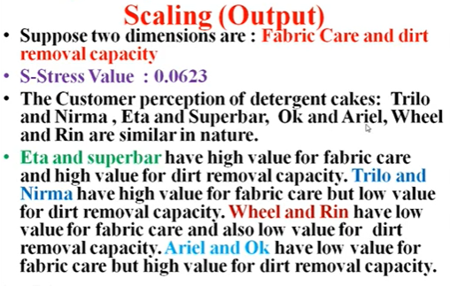
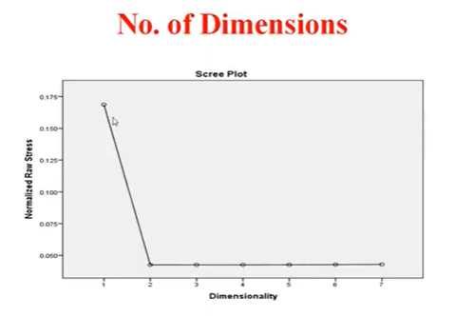
Case study

Slide 32
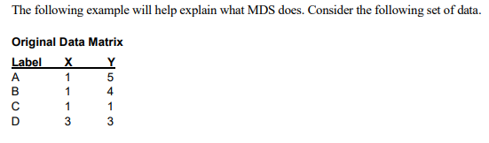
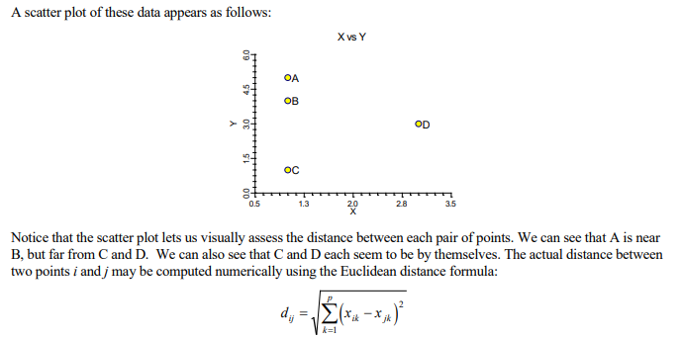
Multi Dimensional Scaling: Example

Slide 33
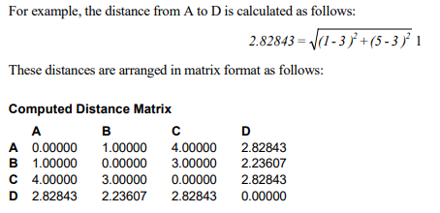
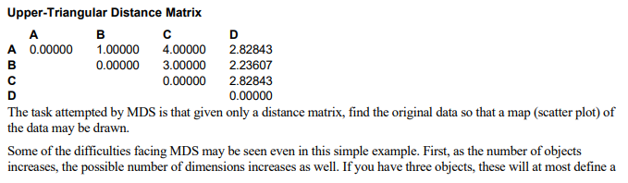
Example for MDS

